Slide 1

Connecting for better…

Slide 2

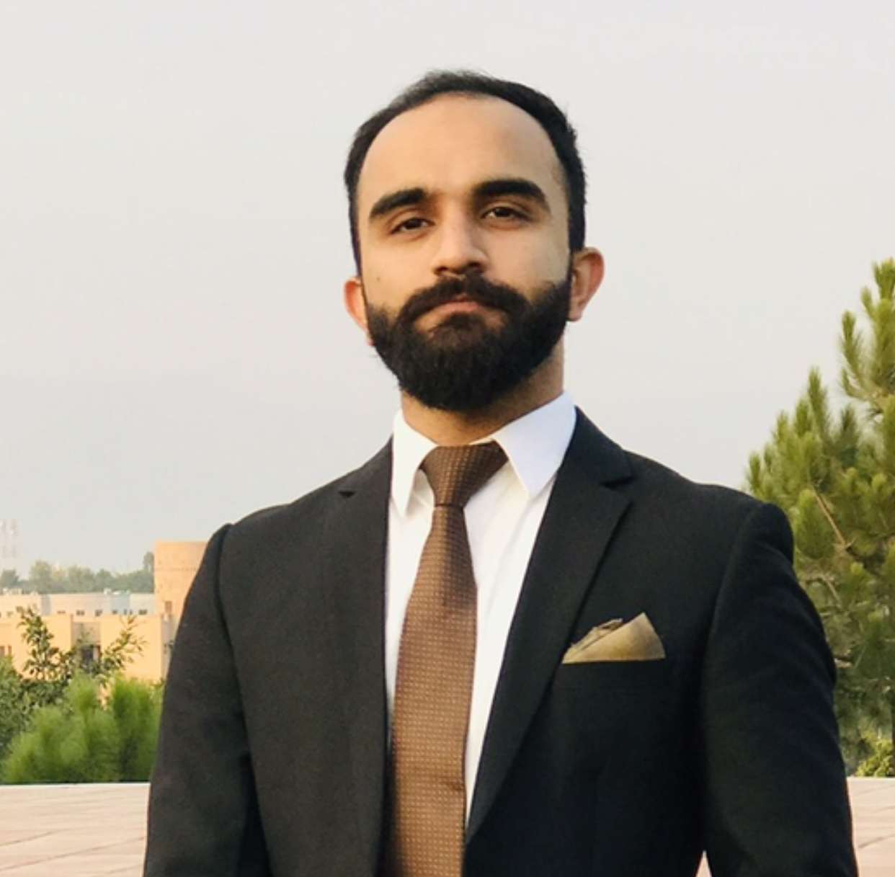
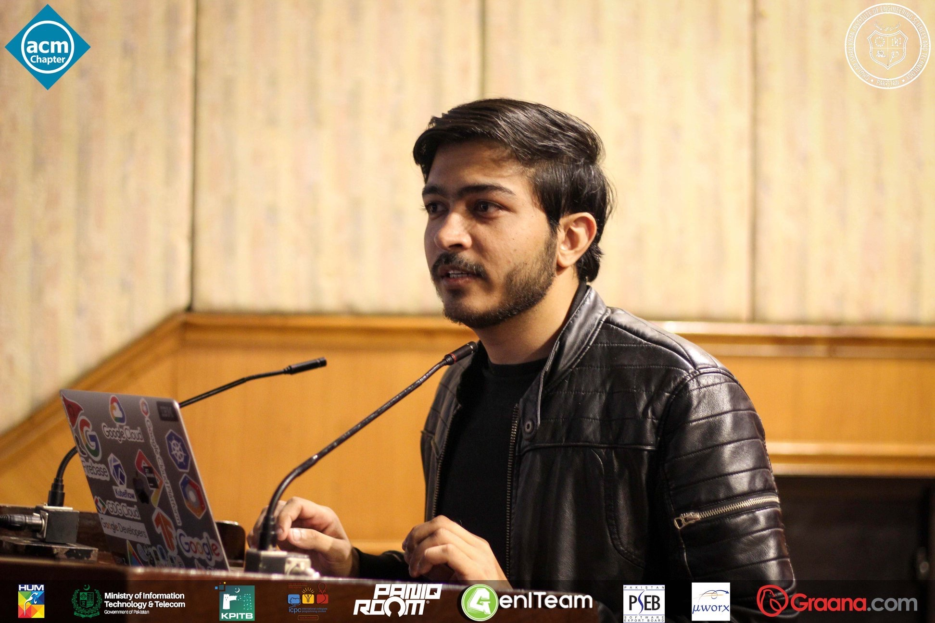
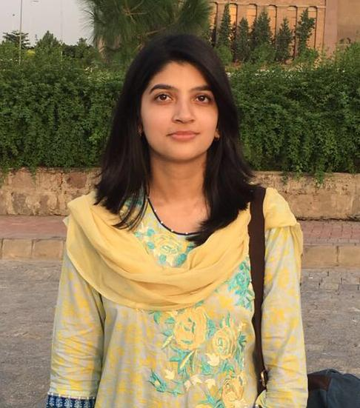

Our Team
JUNAID KHALID
RAMSHA IFTIKHAR
MUHAMMAD AHSAN

Slide 3
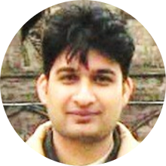
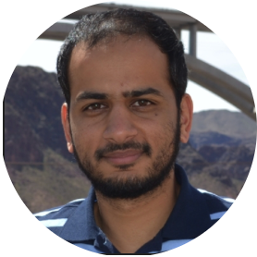
Faculty Advisor
Dr. Ahmed Salman
Faculty Co-Advisor
Dr. Omar Arif

Slide 4
Project Management Phases
Initiation
Planning
Execution
Monitoring and Controlling
Closing

Slide 5
1. Initiation

Slide 6

No centralized platforms between those in need of help and those who are willing to help
Smaller reach/audience of the individuals or platforms who post about people needing financial help
Problem Statement

Slide 7






Facebook posts on profiles to share individual cases
Posting in popular Facebook groups
EXISTING SOLUTIONS
Title here
Title here
Subreddits on Reddit
Newspaper Ads
Title here
Crowd sourcing websites
Whatsapp/Snapchat stories

Slide 8
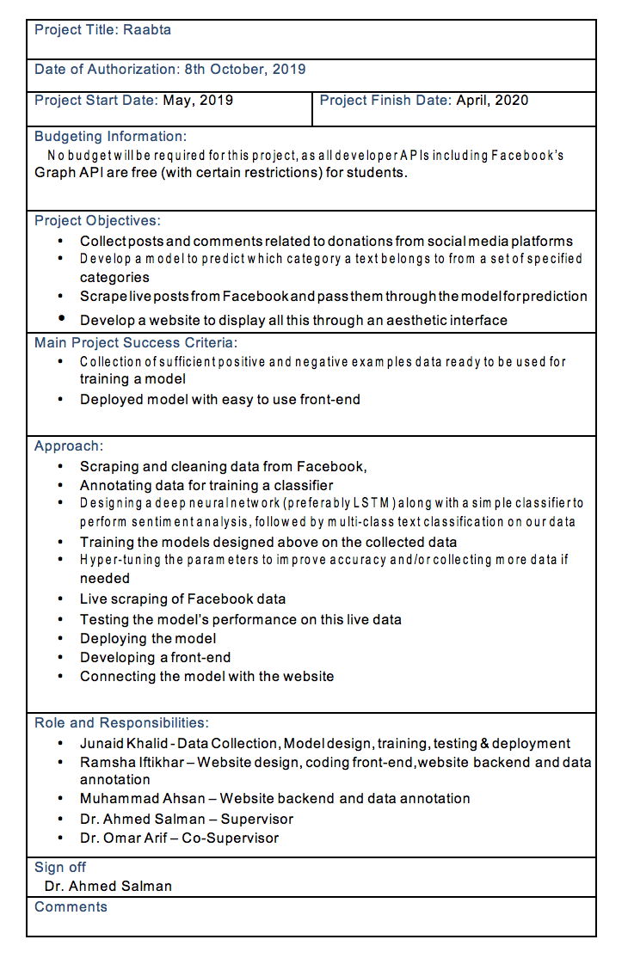
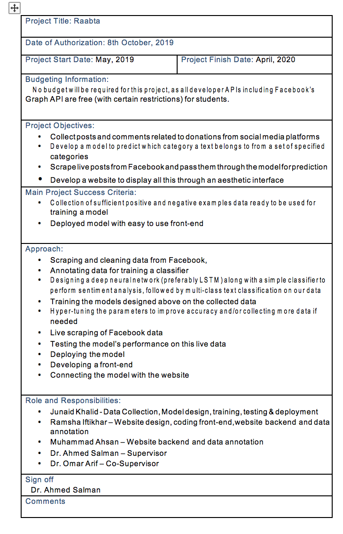
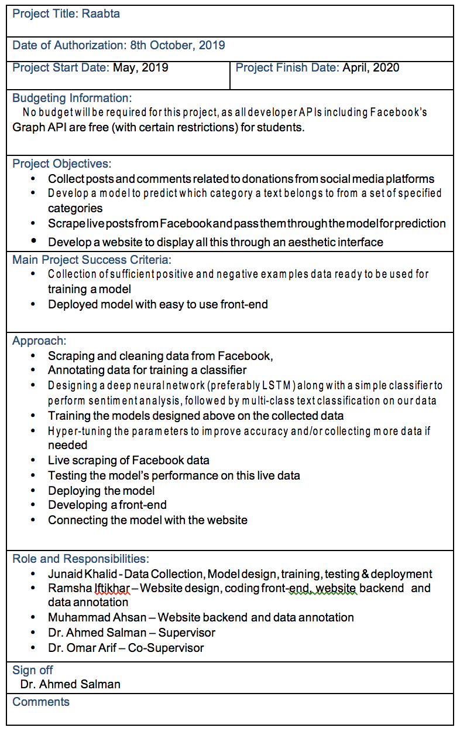
Project Charter

Slide 9
2. Planning

Slide 10
Work Division
Junaid
Data collection
Ramsha
Ahsan
Data preprocessing
Model selection and design
Model training and testing
Model deployment
Data Annotation
Data Annotation
Front end Design and Development
Back end Development
Website Deployment
Documentation
Front end Design and Development
Back end Development
Website Deployment
Documentation

Slide 11



Project Timeline
Develop a pipeline for extracting data in real-time from social media sites
Label 1000 records in seven diverse categories
Week 1-2
Week 7
Week 13-15
Week 3-4
Week 8-10
Requirements elicitation & SRS
Collect a dataset of 5000 instances
Design a pipeline for data pre-processing

Slide 12
Project Timeline (Continued)
Develop website to provide a user-friendly interface
Mid-Defence
Week 20-24
Week 26
Week 31 onwards
Week 25
Week 1-31
Model selection, design, training and testing
Deploy the model on cloud
Deploy Website and Integration with model

Slide 13
5
WEBSITE TIMELINE
4
3
2
1
STEP 1. Website Design
STEP 2. Front-end Development
STEP 3. Backend-end Development
STEP 4. Model Integration
STEP 5. Website Deployment

Slide 14
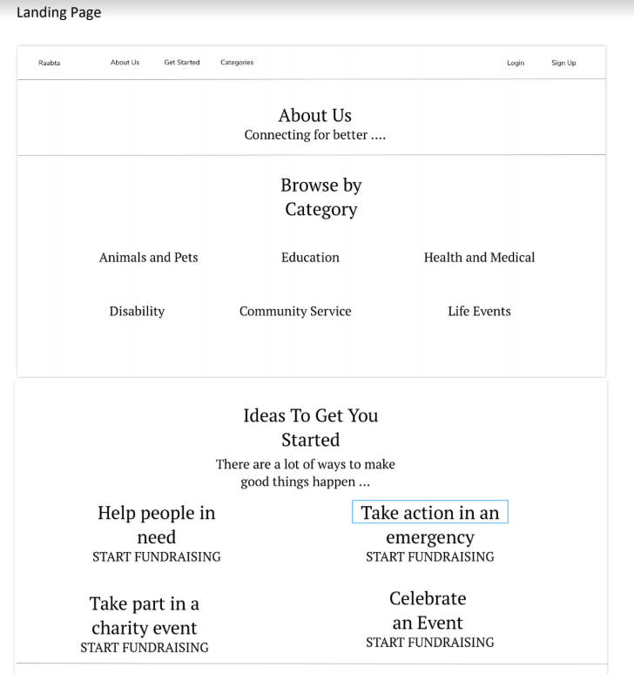

Slide 15
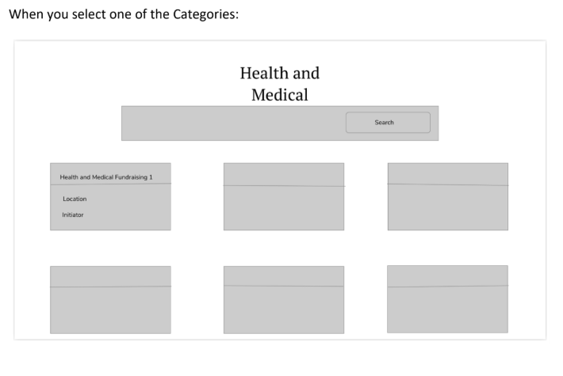

Slide 16
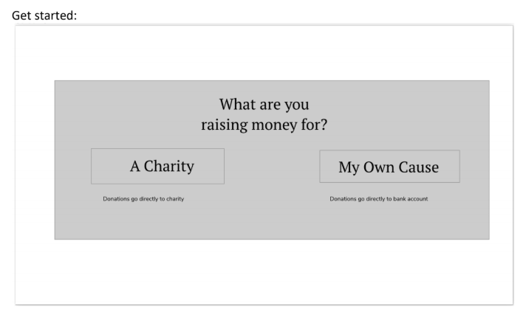

Slide 17
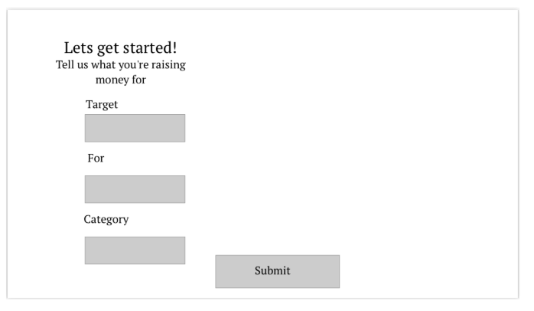

Slide 18
3. Execution

Slide 19
Python
Tensorflow & Keras
Google Colab
Jupyter Notebook
Sklearn
React JS
Git
GitHub
Tools
&
Technologies

Slide 20




Progress
Data Collection and Pre-processing
Website Development
100%
50%
Machine learning model development
100%
20%
Documentation

Slide 21
Machine Learning Progress

Slide 22
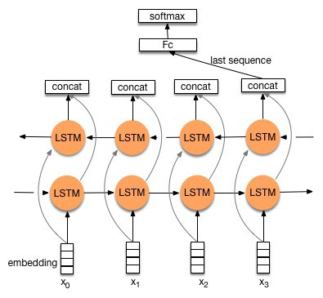
Model Design
Dataset: 726 instances/4000 (scraped)
Train/Test Split: 60-20-20
Model Used: Bi-directional LSTM
Testing Accuracy: 65%
Cut-off Accuracy: 80%
Models tried: SVMs, Decision Trees, Boosted Trees, Neural Networks

Slide 23
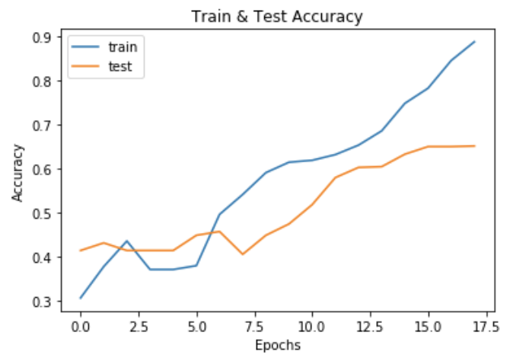

Slide 24
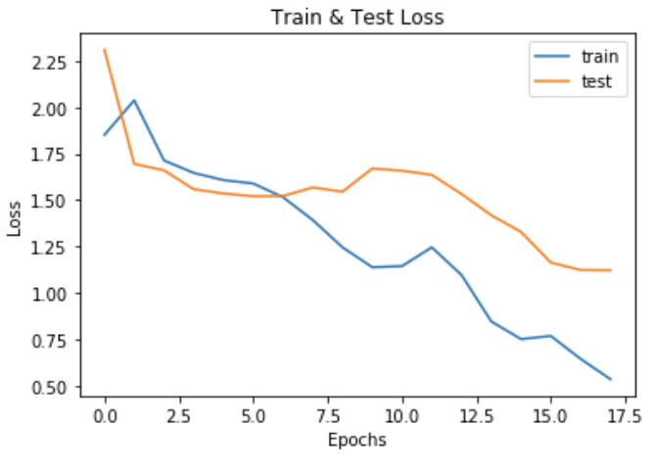

Slide 25
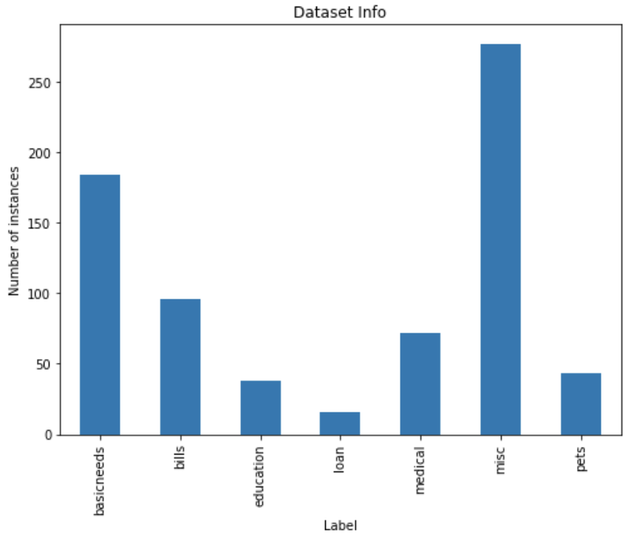

Slide 27
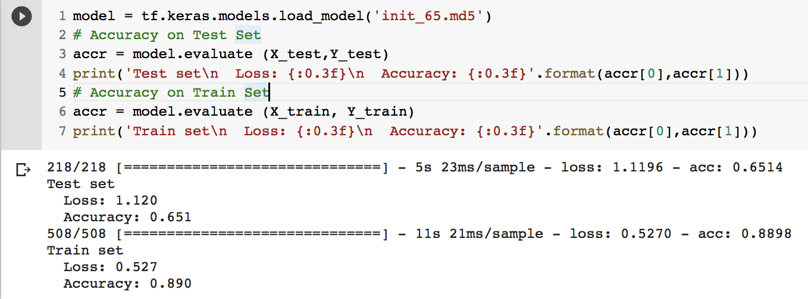

Slide 28
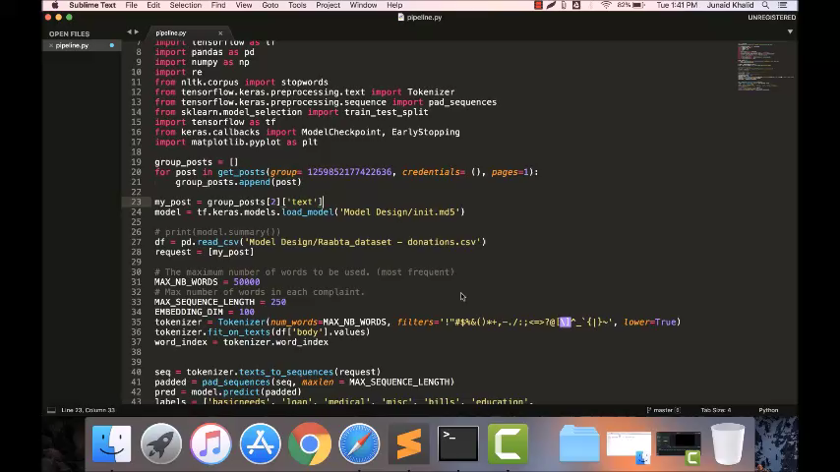

Slide 29
Front-End Progress

Slide 30
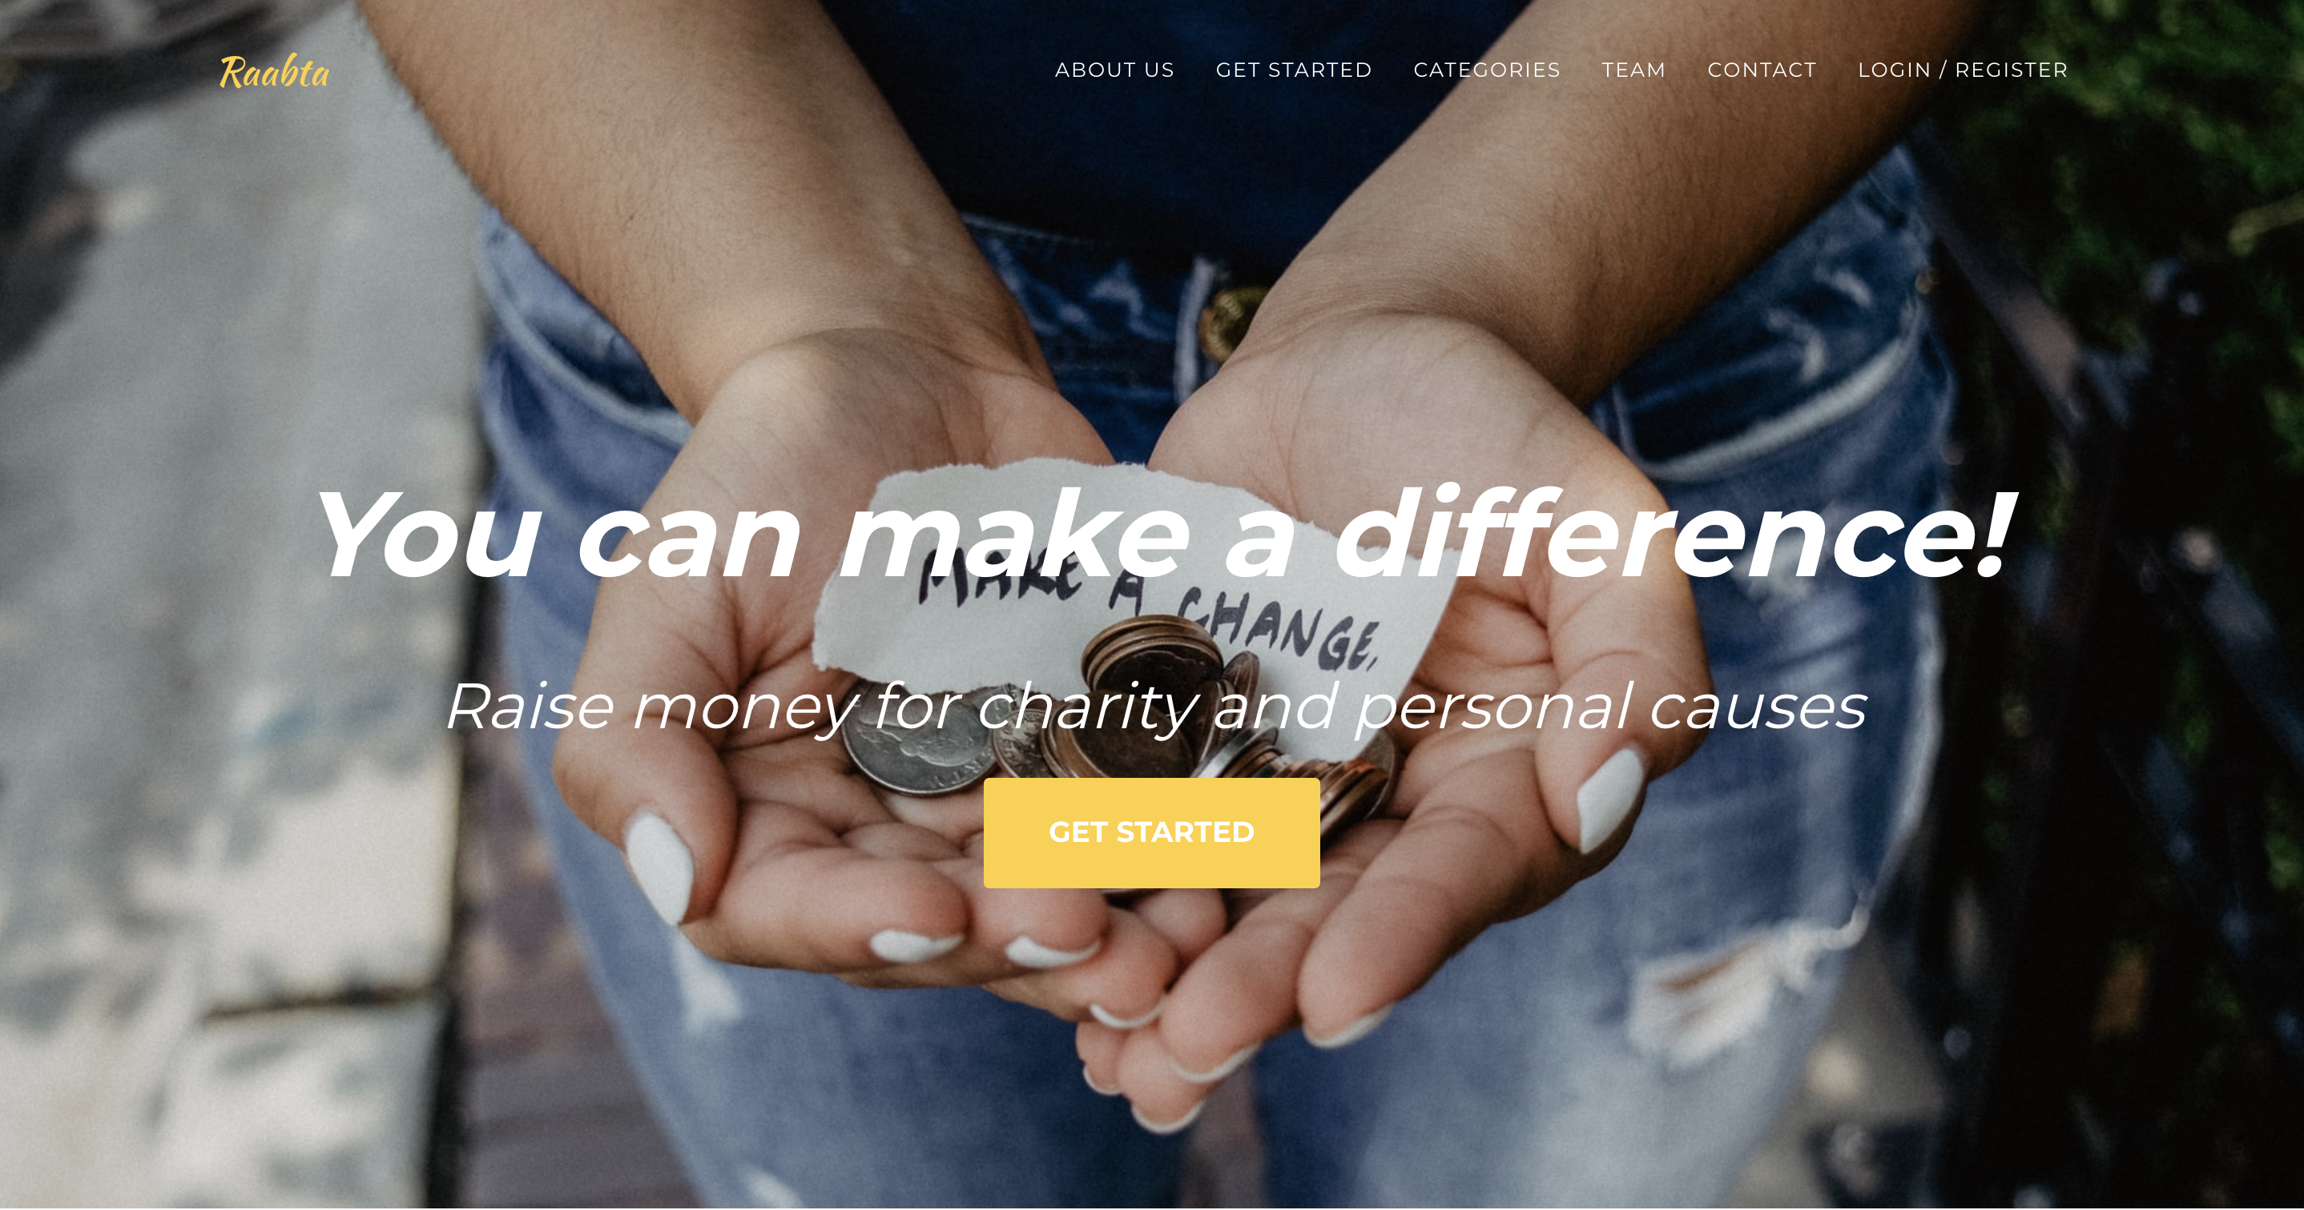

Slide 31
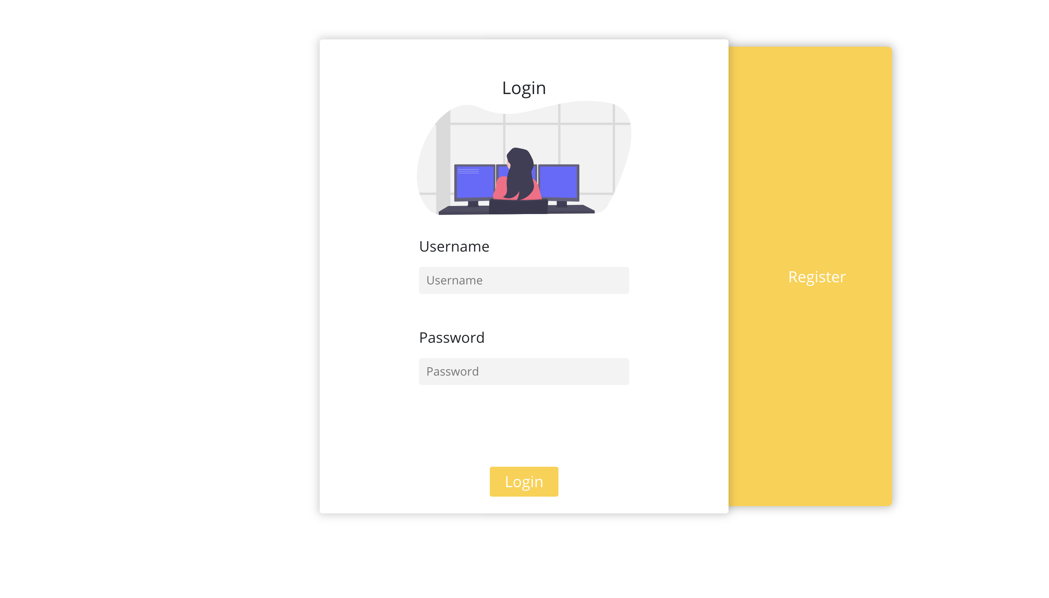

Slide 32
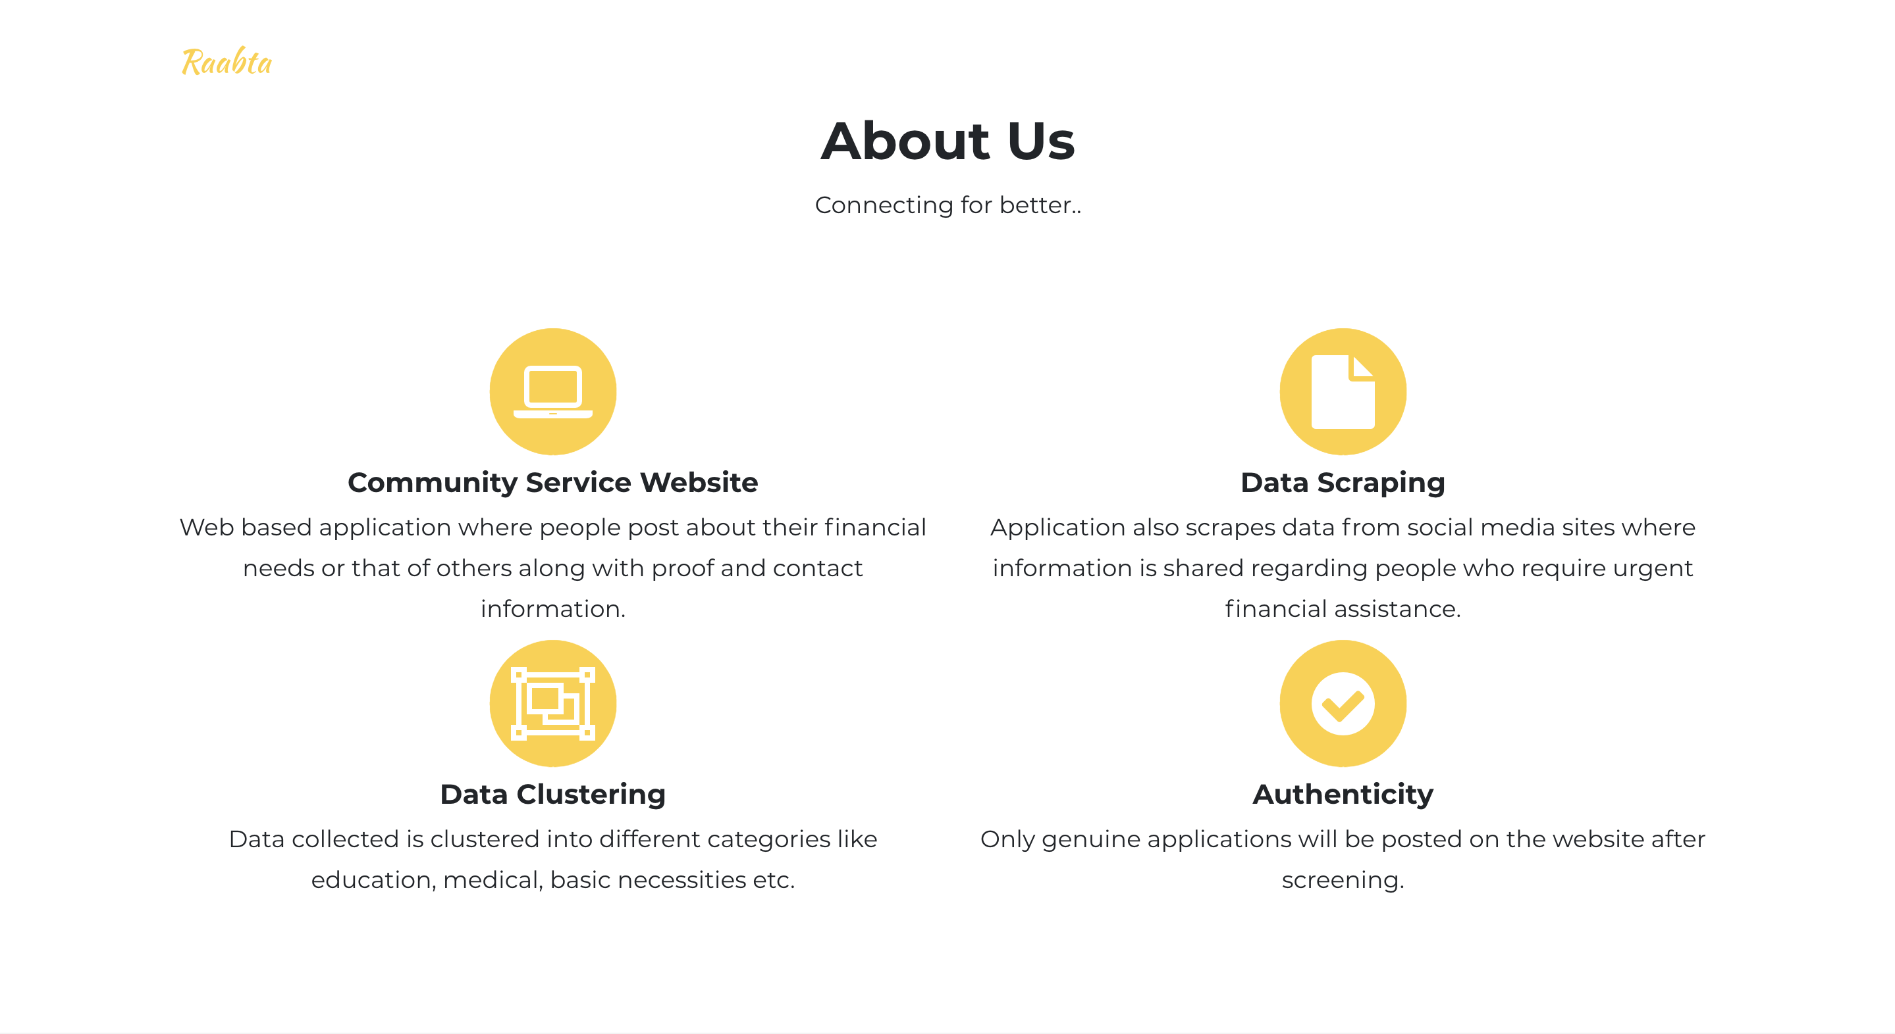

Slide 33
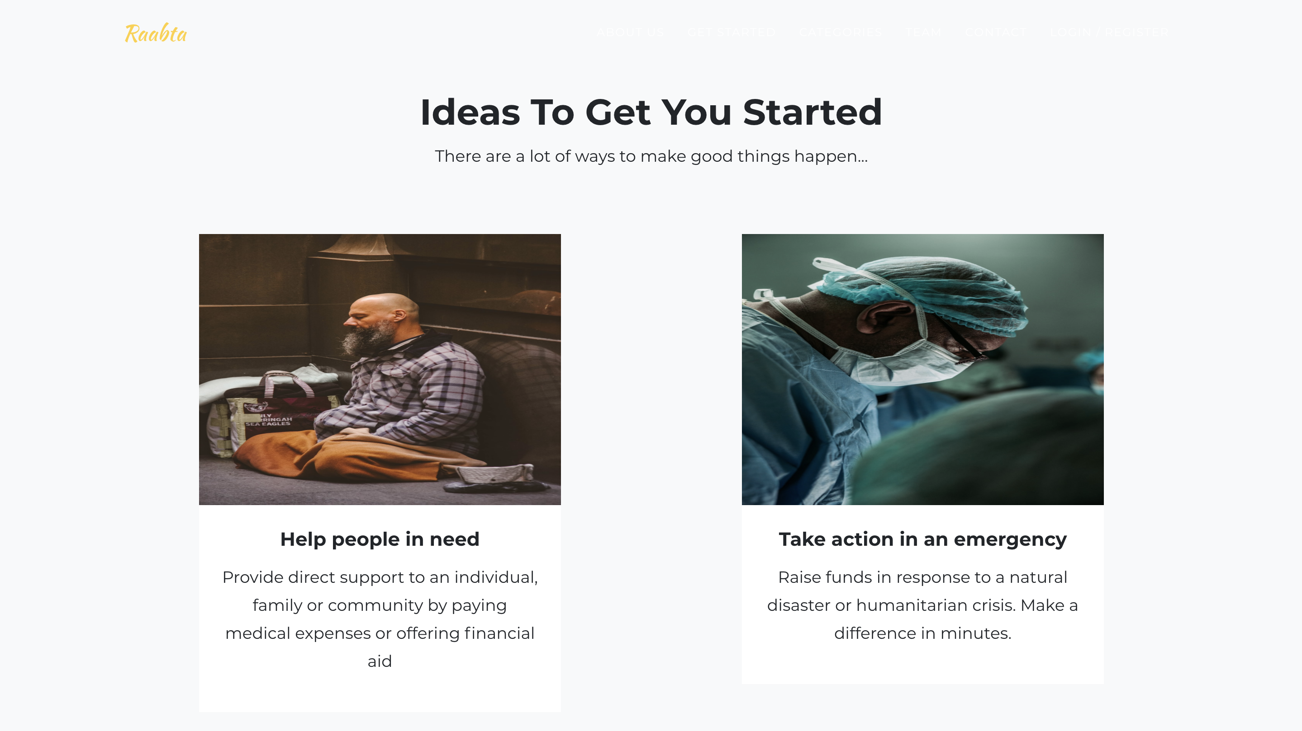

Slide 34


Slide 35


Slide 36
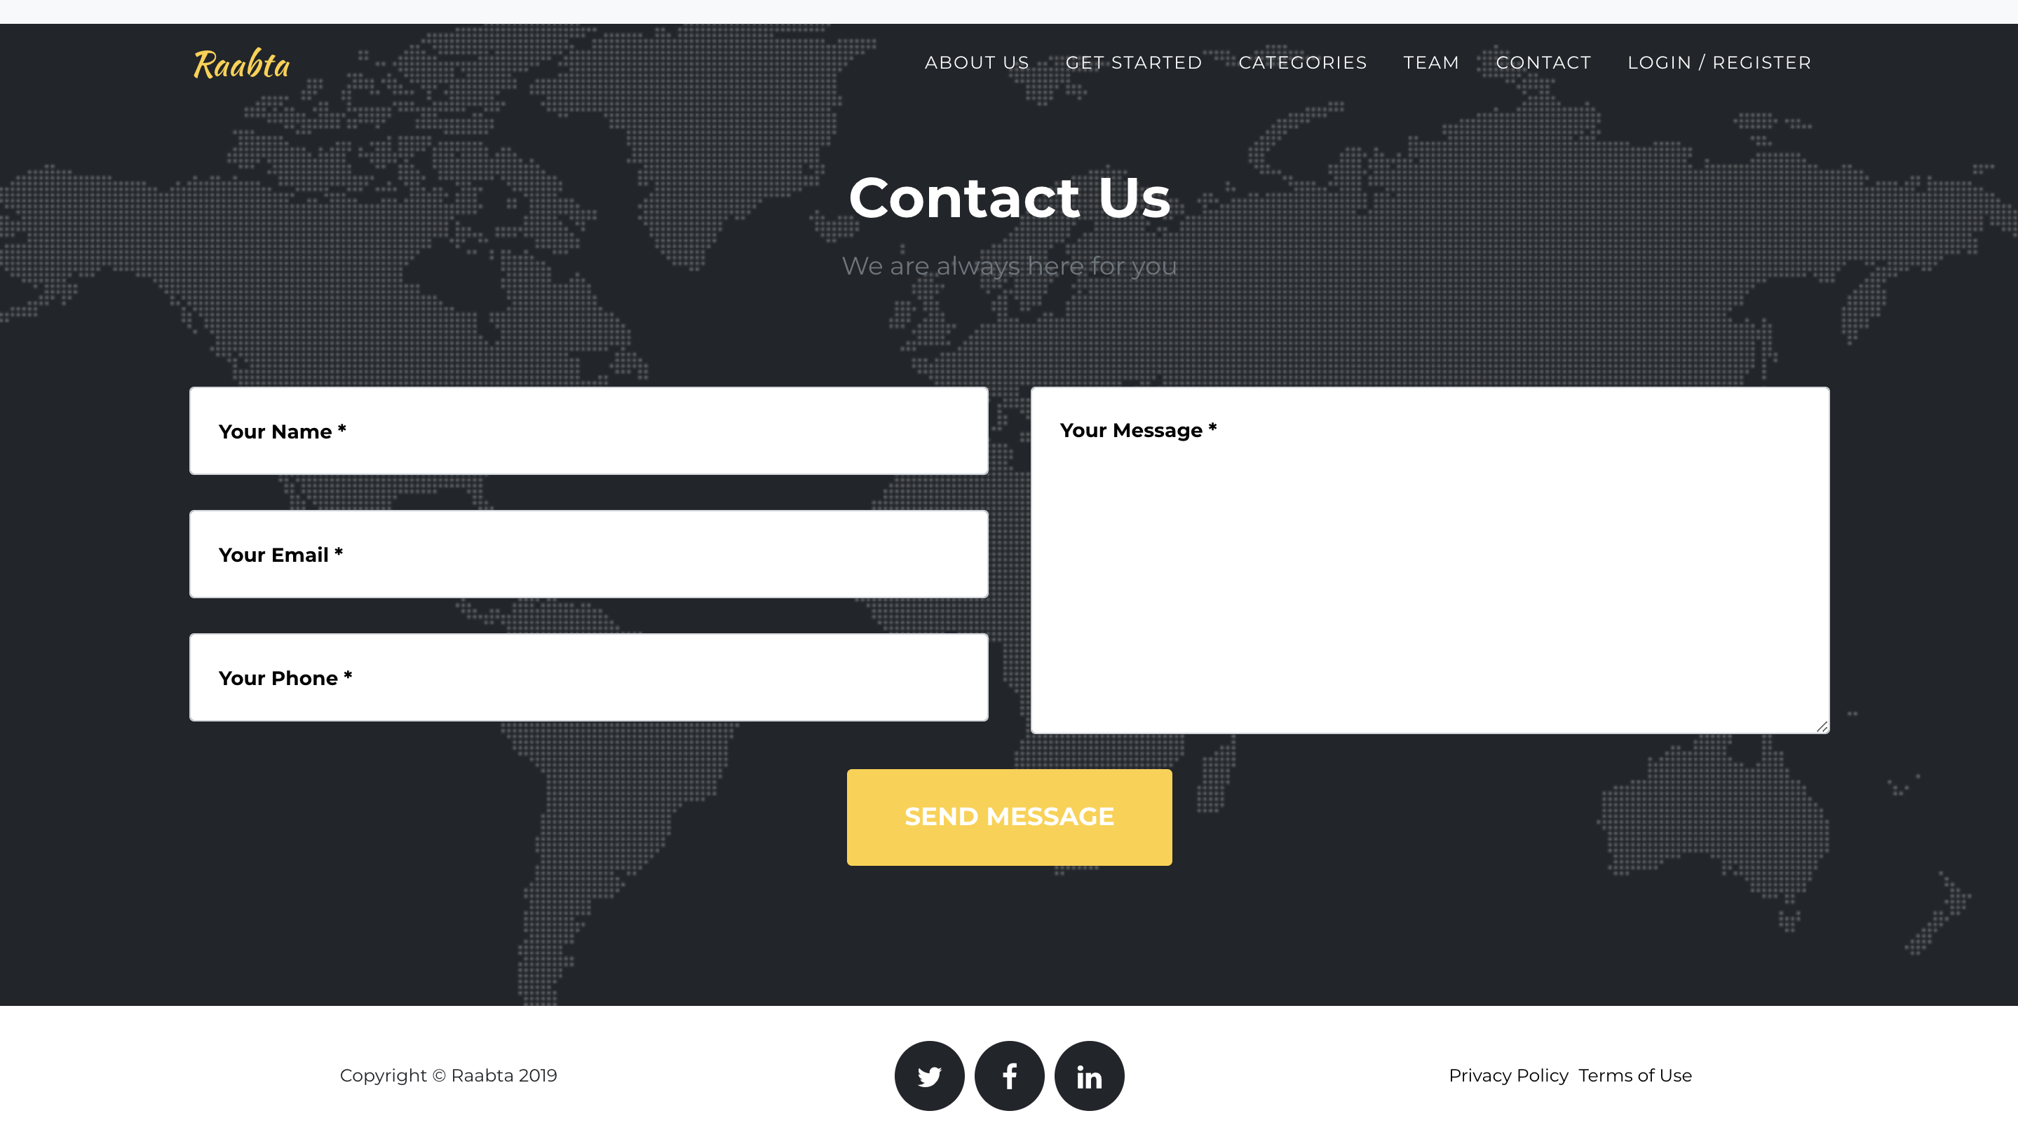

Slide 37
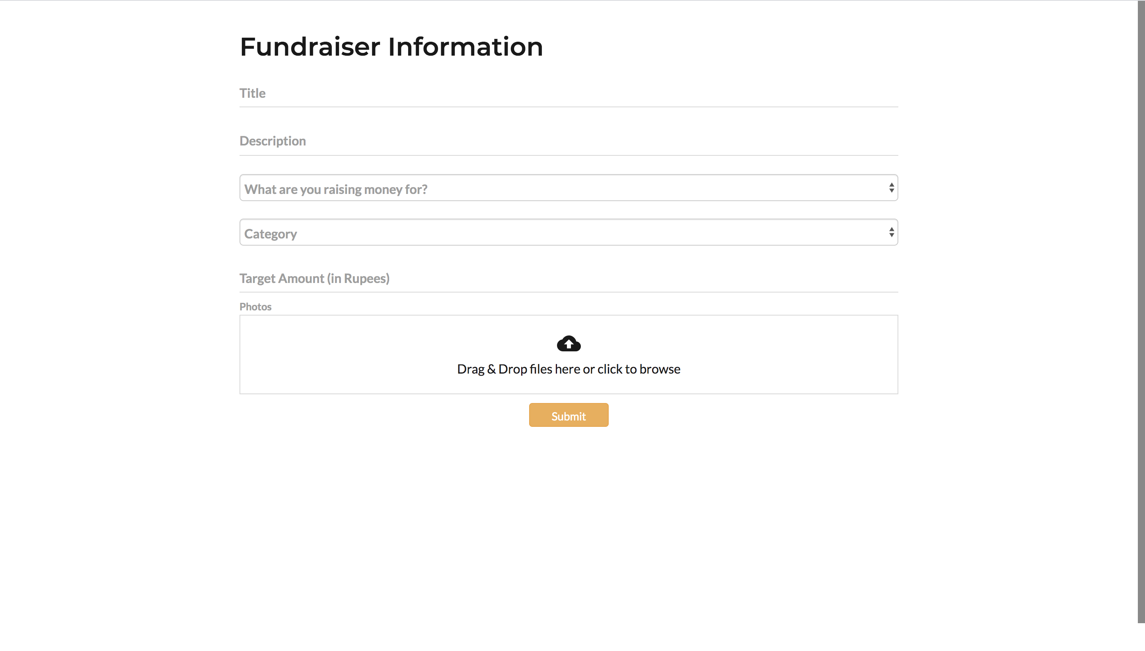

Slide 38
4. Monitoring and Controlling

Slide 39
HURDLES AND DIFFICULTIES
Dataset collection; no public dataset available
Restrictions on extracting data from social media sites
Quality of data
Poor accuracy on most models we tried
No prior experience in web development using React and NodeJS

Slide 40
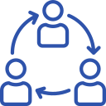



TEAM WORK
COORDINATION
WORK DIVISION
IMPROVISATION

Slide 41
5. Closing

Slide 42





MODEL AND WEBSITE DEPLOYMENT
WEBSITE BACKEND
MODEL AND WEBSITE INTEGRATION
DATA LABELLING
HYPER-TUNING OF PARAMETERS
WHATS NEXT?

Slide 43
THANK YOU!

